Slide 1

By:
Nicholas Vallarelli, Ojonugwa Oji, Verena Barth,
Payal Narkhede, and Vishnu Mullick

Slide 2
COBOL History
COBOL means ‘Common Business Oriented Language’
It was formed in 1959
One of the earliest high level programming languages
CODASYL: the Conference/Committee on Data Systems Languages - used to guide the development of programming languages that could be used on many computers
Was partly based on previous programming language design by Grace Hopper who created one of the first English-like data processing language
Multi Platform Computer
A scalable language
Still used today

Slide 3
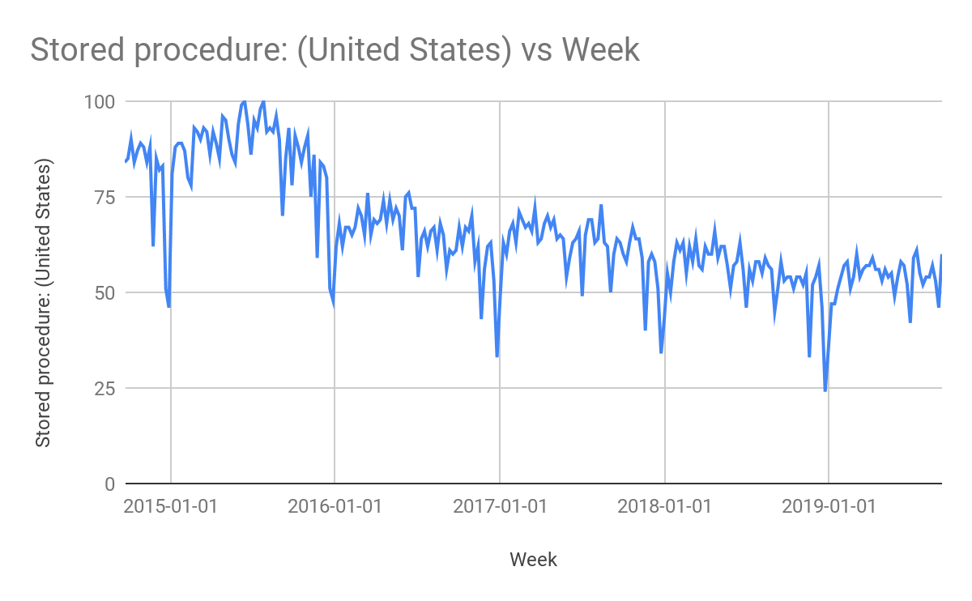
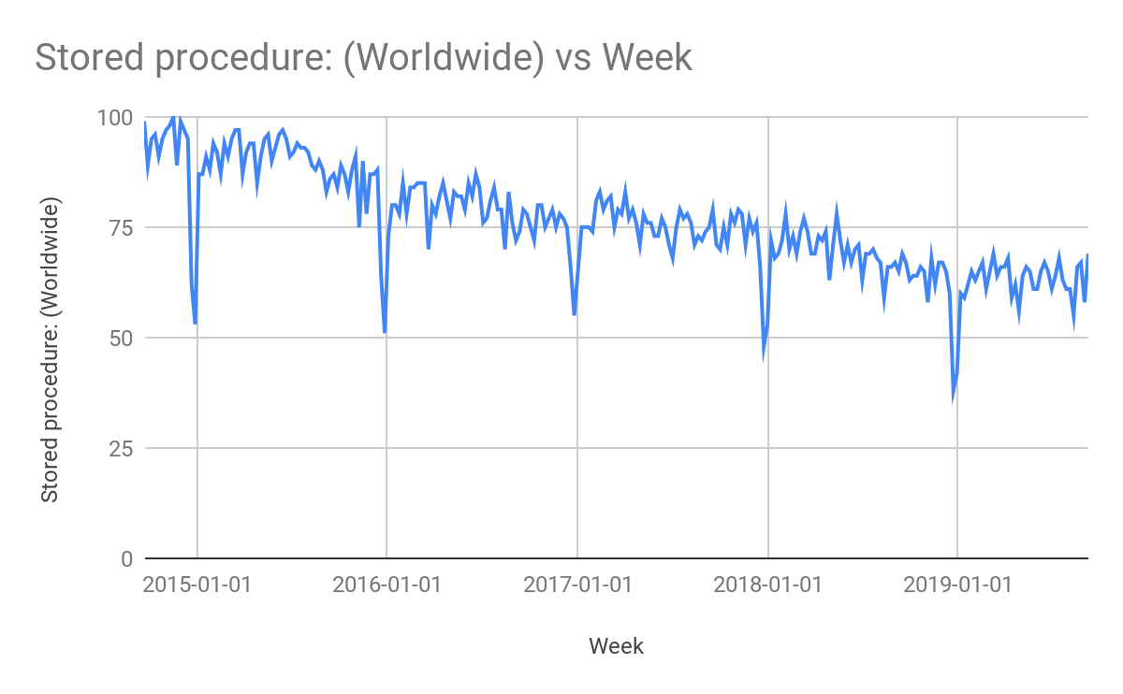
Google Trends: COBOL
USA
GLOBAL
City: (40)
Eden Prairie
NY number (20th)
Least is Philly
World: (70)
China
US (18th)
Brazil

Slide 4
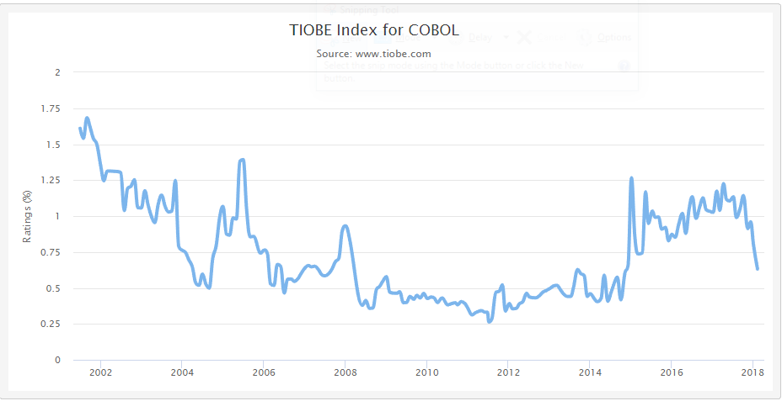
TIOBE: COBOL
35

Slide 5
Range of use
Business, finance, administrative systems, banking
Mainframe computers
→ High performance, accuracy
70 - 80%
of all business transactions
95% ATM transactions
daily
~ 220 Bn
lines of code
Notes:
Although you might not expect it, the majority of businesses stand today on COBOL
Cobol still runs the world in traditional banking, lots of large scale government systems, insurance and health care.
It's often used in mainframe computers, e.g. IBMs operating system z/OS and it's good for large-scale batch and transaction processing jobs.
Today
220 Billion lines of code are written in COBOL
Social Security Administration (60 million lines)
IRS (Internal Revenue Service), 50 million lines
Airlines
Nowadays 1.5 billion new lines get written every year, mostly just to keep existing systems alive.
COBOLs main usage is in the financial sector:
70-80% of all business transactions worldwide are written in COBOL So 200 times as many COBOL transactions take place each day than Google searches
7% of the American GDP is dependent on COBOL in the form of payments from the Center for Medicare & Medicaid Services
95% ATM transactions daily
----------------------------------------------------------------------------------------------------
You might ask yourself the question why we haven't replaced this old, outdated language with something better yet.
Because first but not least
If it ain’t broke, don’t fix it. These more than 30 year old systems are reliable and do what they're supposed to do.
Also they deal with lots of sensitive information, like social security numbers, banking info, credit card info and healthcare records.
Changing it is very risky and expensive because the systems are complex and envolved over years.
Also
It still is very steady and performant
And math hasn’t changed yet.
It's very good in handling monetary calculations, because it uses fixed point over floating point.
This makes calculations very exact which is impossible to achieve using language like Java/Python. If you're interested in this topic, take a look at "Mullers recurrance".
So using this precise calculating language is essential in the financial sector.
Therefore the range of use of COBOL nowadays is still very big and developers are urgently needed, because the average age of a COBOL developer is 55.

Slide 6
Features of COBOL
Standard Language
Can be compiled on machines
No pointers
No user defined types or functions
Business Oriented
Can easily handle large amounts of data
Advanced file handling capabilities
Robust Language
Can be debugged, tested, and compiled on almost every platform
Structured Language
Language is very easy to read
Can be debugged reliably

Slide 7
Features Exclusive to COBOL
Long Lasting
Has adapted to new changes and continues to be used across all platforms
Receives new updates every year
Work Friendly
Works excellently in a business setting
If maintained, COBOL projects can last decades
Reliable with high-budget projects
Versatility
Continues to serve as the primary foundation for many computer mainframes
Hundreds of companies still use COBOL to this day

Slide 8
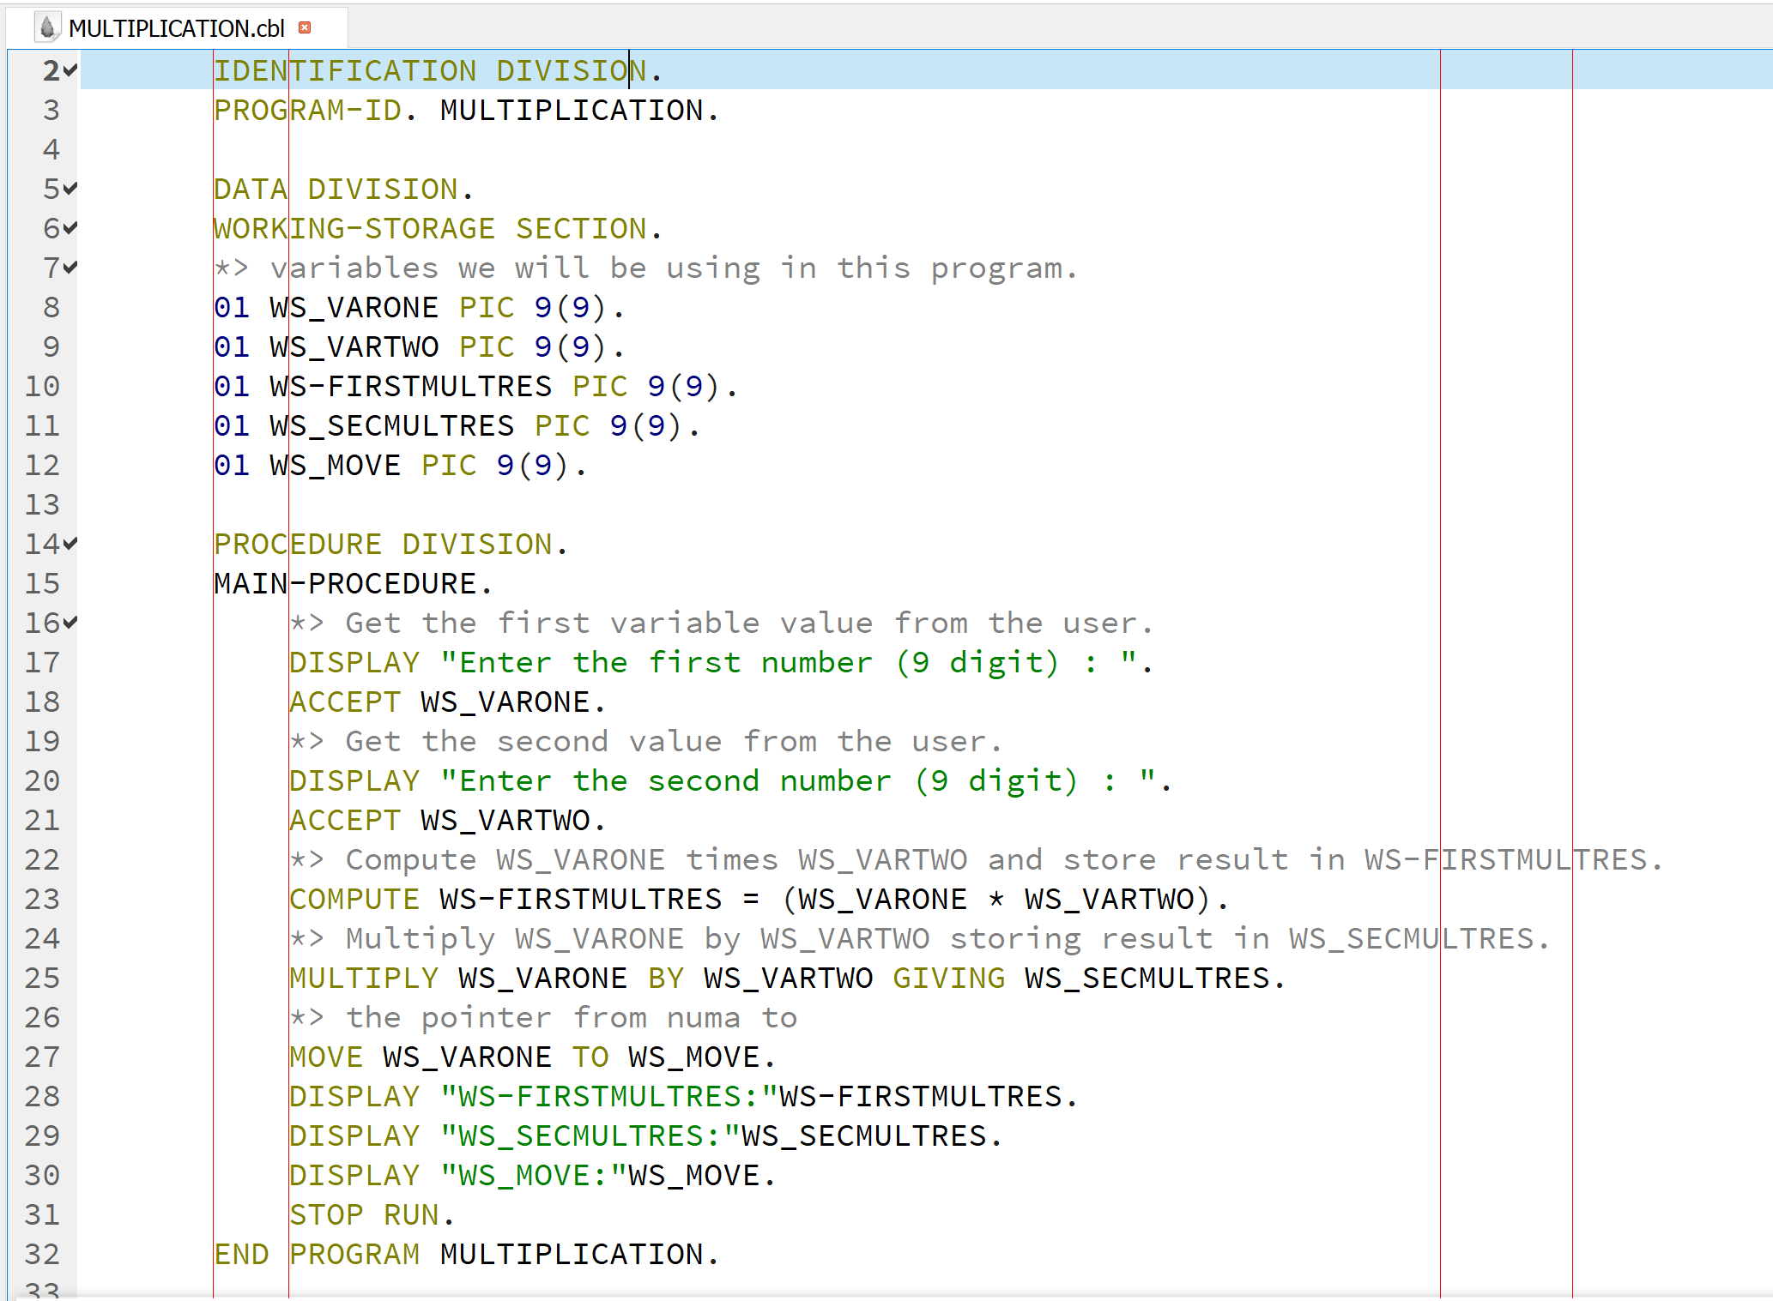
COBOL Code
OpenCOBOL IDE
Multiplication Program
Source code is divided in following divisions:
Identification Division
Environment Division
Data Division
Procedure Division

Slide 9
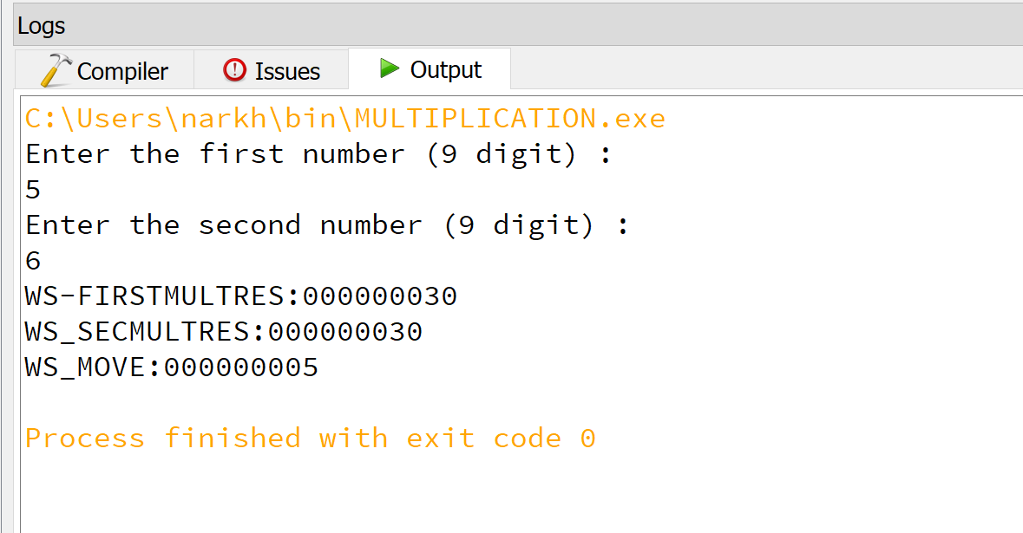
COBOL Code Result

Slide 10
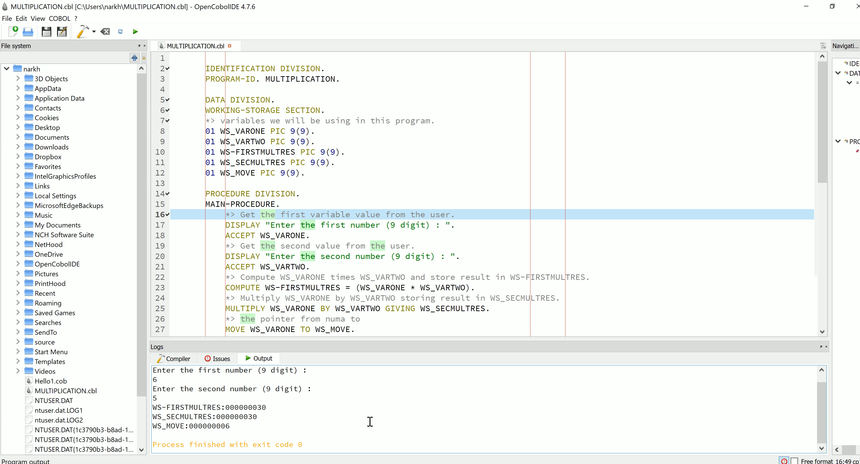
COBOL Code Video

Slide 11
Conclusion
COBOL is very interesting, easy to learn, and a widely used language for business and financial applications which was designed to accommodate complex data sets while efficiently using computer resources.

Slide 12
References
https://www.tutorialspoint.com/cobol/cobol_overview.htm
https://medium.com/@yvanscher/7-cobol-examples-with-explanations-ae1784b4d576
https://medium.com/@bellmar/is-cobol-holding-you-hostage-with-math-5498c0eb428b
https://blog.hackerrank.com/the-inevitable-return-of-cobol/
https://www.backbase.com/2018/04/19/cobol-and-the-big-tin-bank/
https://cacm.acm.org/news/231386-do-you-know-cobol-if-so-there-might-be-a-job-for-you/fulltext
https://ieeexplore.ieee.org/document/841602
https://www.csee.umbc.edu/courses/graduate/631/Fall2002/COBOL.pdf
https://www.cleverism.com/skills-and-tools/cobol/
https://developer.ibm.com/mainframe/2019/02/26/cobol-and-the-enterprise-business-programming-paradigm/
https://www.techopedia.com/definition/25326/legacy-code
Download IDE
https://launchpad.net/cobcide/+download
Notes:
https://www.tutorialspoint.com/cobol/cobol_overview.htm
Scher, Yvan. “7 cobol examples with explanations.”. Medium, 01. Aug. 2018, https://medium.com/@yvanscher/7-cobol-examples-with-explanations-ae1784b4d576 (visited on 13. Sept. 2019)
Bellotti, Marianne. “Is COBOL holding you hastage with Math?”. Medium , 28. Jul. 2018, https://medium.com/@bellmar/is-cobol-holding-you-hostage-with-math-5498c0eb428b (visited on 19. Sept. 2019)
Trikha, Ritika. “The Inevitable Return of COBOL.” HackerRank Blog, 29 Sept. 2018, https://blog.hackerrank.com/the-inevitable-return-of-cobol/ (visited on 14. Sept. 2019)
Maat, Jenny. “COBOL and the big tin bank”. Backbase, 19. Apr. 2018, https://www.backbase.com/2018/04/19/cobol-and-the-big-tin-bank/ (visited on 14. Sept. 2019)
https://cacm.acm.org/news/231386-do-you-know-cobol-if-so-there-might-be-a-job-for-you/fulltext
J.E.Samet, Bethesda, MD,USA. “The Real Creator of COBOL” .(March- April 2000) https://ieeexplore.ieee.org/document/841602
Li, Jiehong, Abraham, Rona, UMBC CMSC631, https://www.csee.umbc.edu/courses/graduate/631/Fall2002/COBOL.pdf
https://www.cleverism.com/skills-and-tools/cobol/

